Slide 1
Evaluation testcase
Mutation testing
Fuzzing

Slide 2
Unit test
Unit test is function, test library will automatically find test function by function name or annotation.
Remember keyword: assert, raise

Slide 3
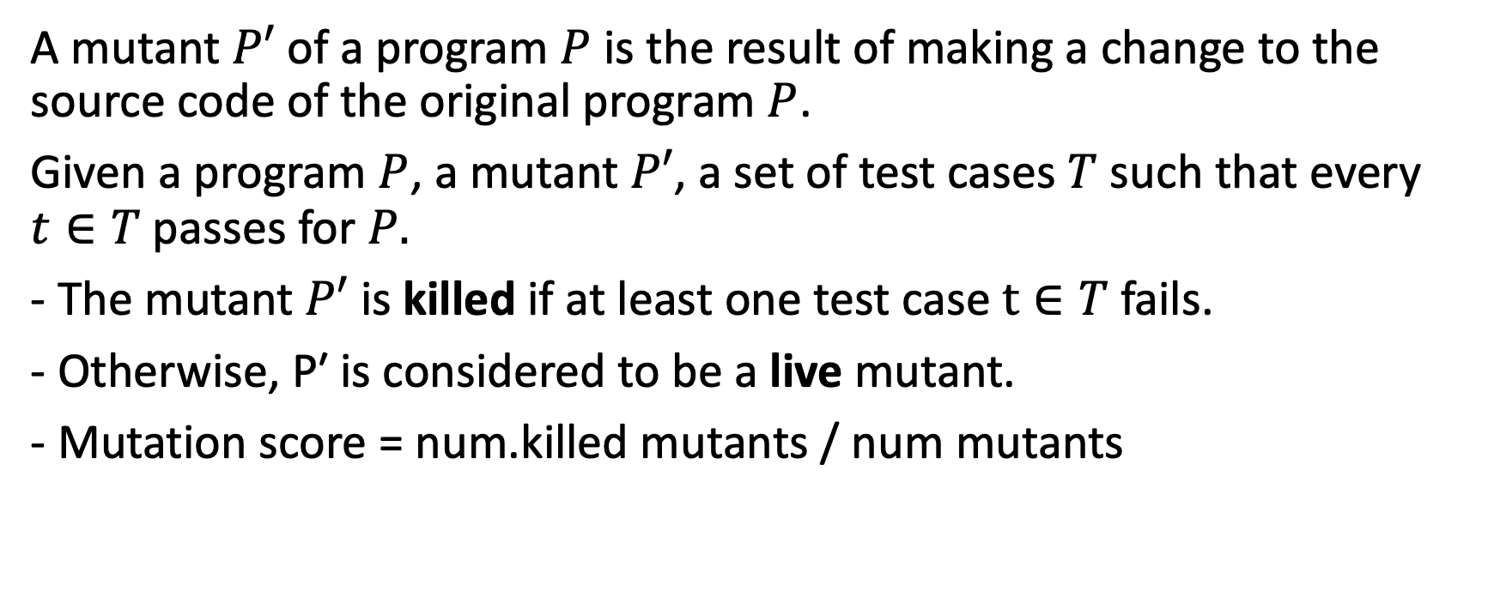
Mutation testing: basic concept
A mutant $P′$ of a program $P$ is the result of making a change to the source code of the original program $P$.
Given a program $P$, a mutant $P′$, a set of test cases $T$ such that every $t∈T$passes for $P.$
- The mutant $P′$ is killed if at least one test case $t∈T$fails.
- Otherwise, P′ is considered to be a live mutant.
- Mutation score = num.killed mutants / num mutants

Slide 4
Mutate operators
A = {+, –, *, /, %}, R = {<=, ==, ≠, >, >=}, L = {∧, ∨, ⊕, ∼, →}
Example:
if ( i >= 0 ) { return "foo"; } else { return "bar"; }
if ( i > 0 ) { return "foo"; } else { return "bar"; }

Slide 5
Practices
Using PITEST package in Java.
<plugin>
<groupId>org.pitest</groupId>
<artifactId>pitest-maven</artifactId>
<version>1.7.6</version>
<dependencies>
<dependency>
<groupId>org.pitest</groupId>
<artifactId>pitest-junit5-plugin</artifactId>
<version>0.15</version>
</dependency>
</dependencies>
</plugin>

